Slide 1
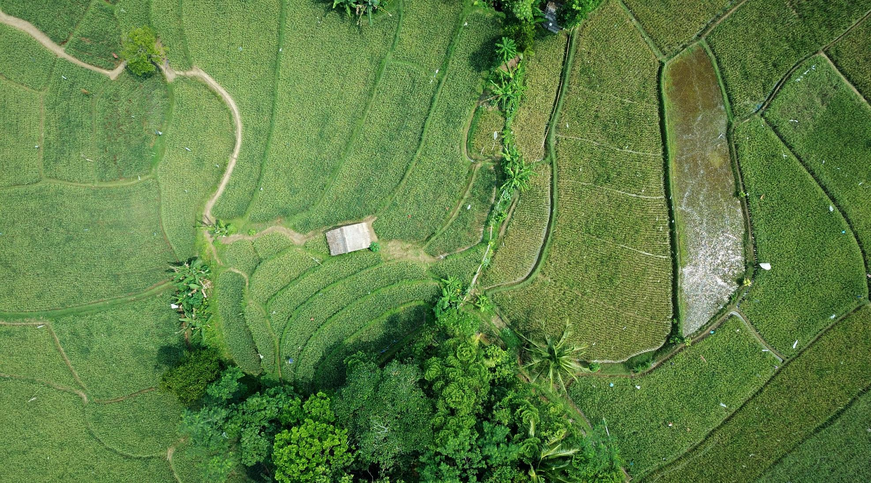
city against nature

Slide 2
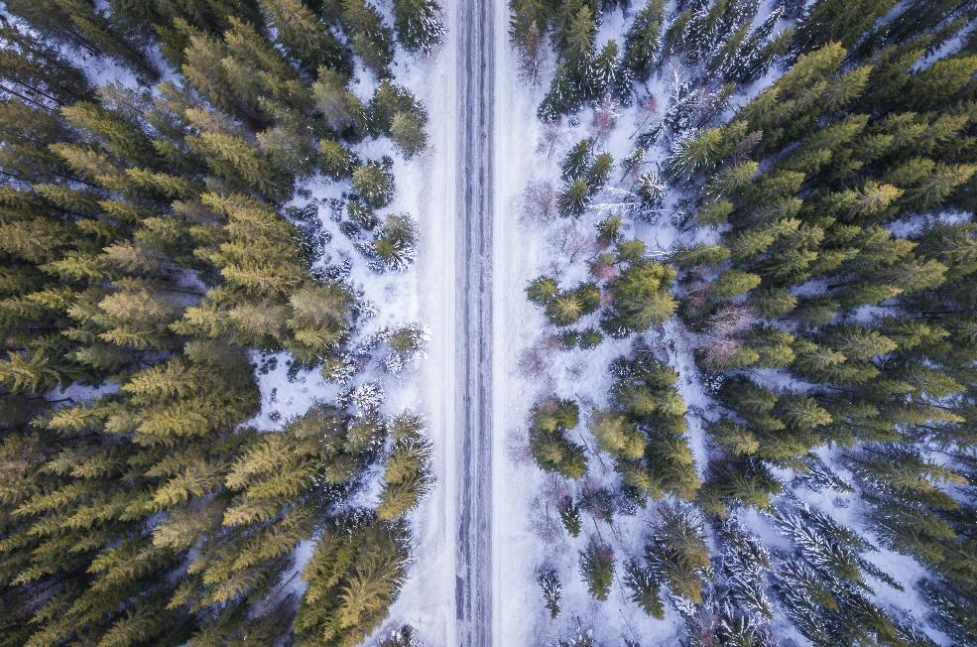
Introduction
St. Petersburg is one of the most beautiful cities. There are many park areas here. I bought an apartment in St. Petersburg 10 years ago on the outskirts of the city. There were a lot of green areas nearby. But over the past 10 years, the area has become heavily built up. Fewer and fewer places to stay. This situation is not only in my area. Environmental issues come first. I tried to show the problem centers in this project. Perhaps such mechanisms should be used by the city government for planning construction.

Slide 3
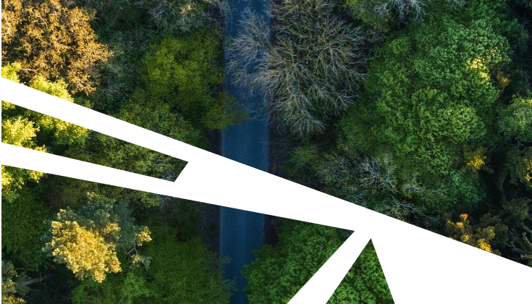
Data preparation
This notebook is very inspired by the work I found for the example (https://www.kaggle.com/aquadrox/week-4-capstone-the-battle-of-the-neighborhoods). I'll keep the idea of clustering the city by area and then build a heatmap to find the best area.
I will change some data:
Country / city: Russia Objective: find areas without access to parks So, I will be crossing data from business days and localizations.
I will be using the following API:
Foursquare API: for finding parks
geopy: reverse geolocation

Slide 4
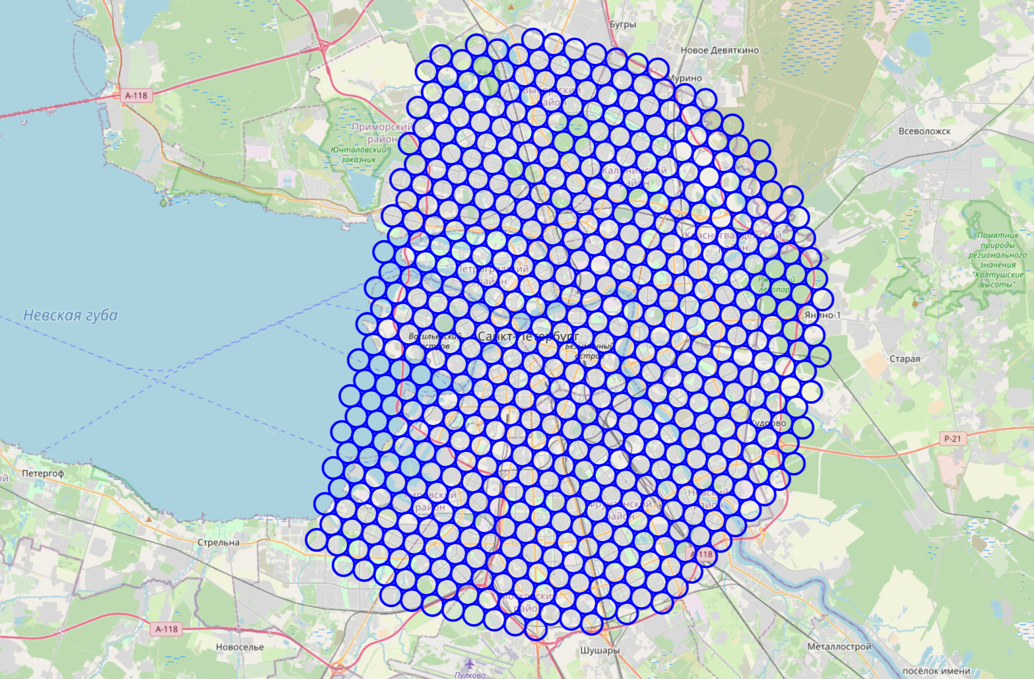
City partitionning
We create a grid of area candidates, equaly spaced, centered around city center and within ~15km. Our neighborhoods will be defined as circular areas with a radius of 500 meters, so our neighborhood centers will be 1000 meters apart.

Slide 5
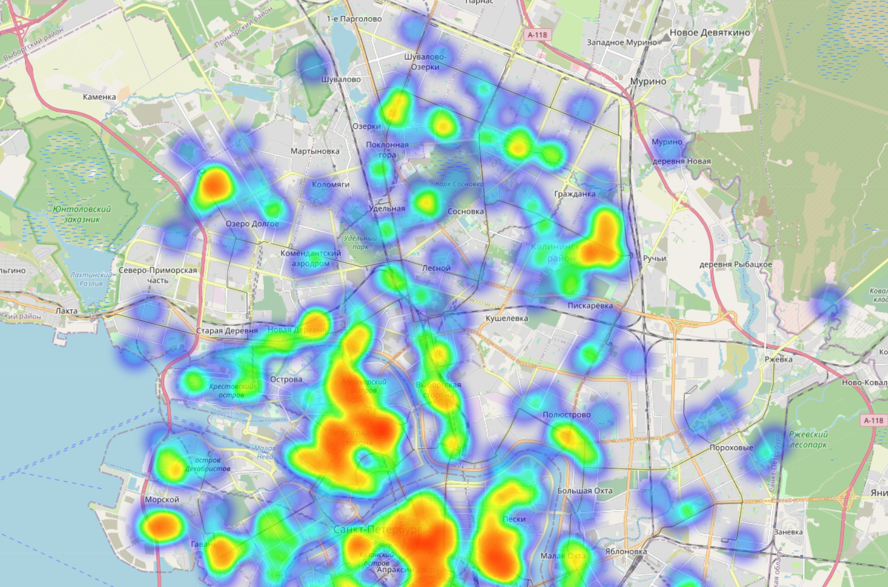
Methodology
Foursquare Now that we have our location candidates, let's use Foursquare API to get info on parks in each neighborhood.

Slide 6
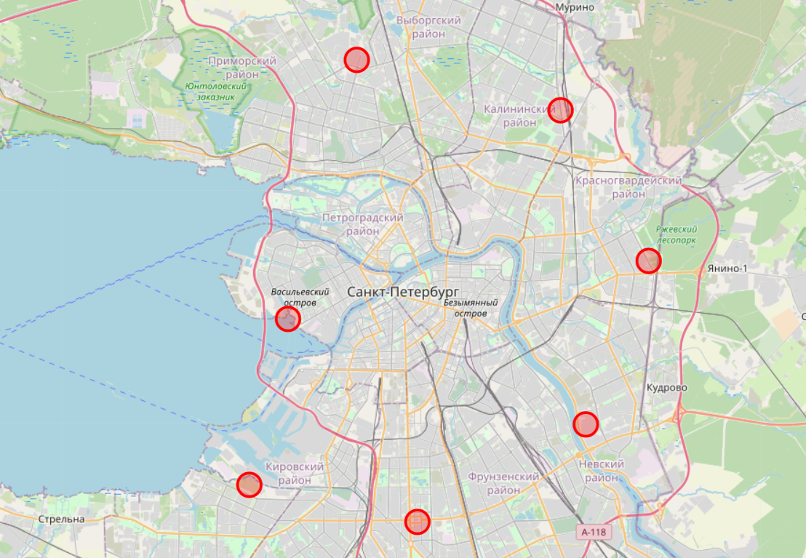
Clustering result
We cluster those bad locations to create centers of zones containing bad locations. Those zones, their centers and addresses will be the final result of our analysis.

Slide 7
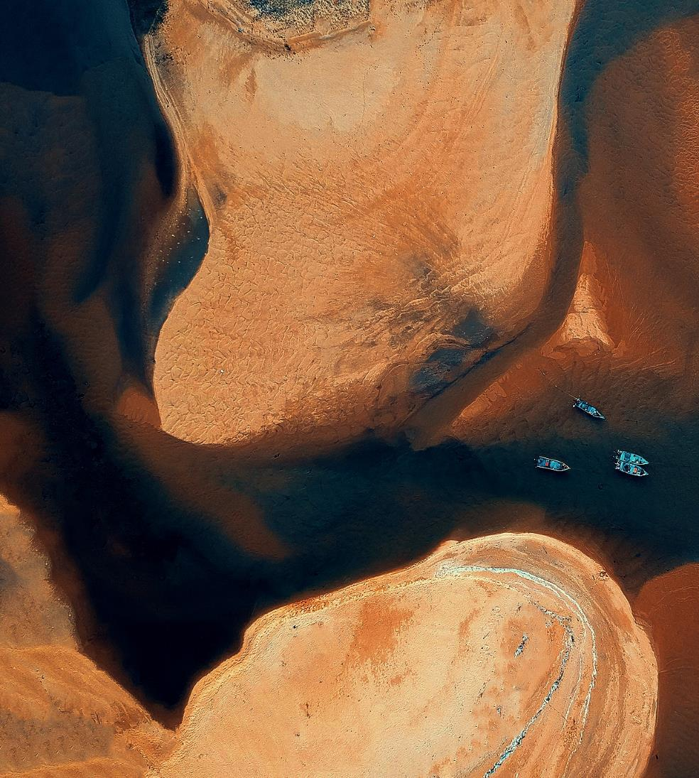
Conclusion
This project can be reused for other cities, just think about changing clustering size to adapt to your city.
It's very far from being perfect, a lot of work can be done, other source of data can be found, but in the end the result seams to correlate with the real world, when we know the city, the area predicted seams correct.

Slide 8
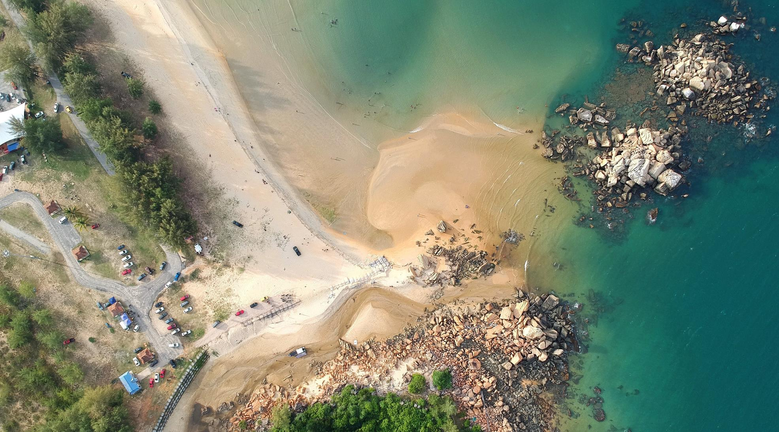




Thanks for attention!
Denis Shlyakhtin

